Slide 1
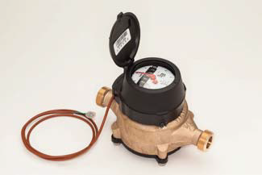
Fluid flow
FLOW RATE AND VELOCITY MEASUREMENT

Slide 2
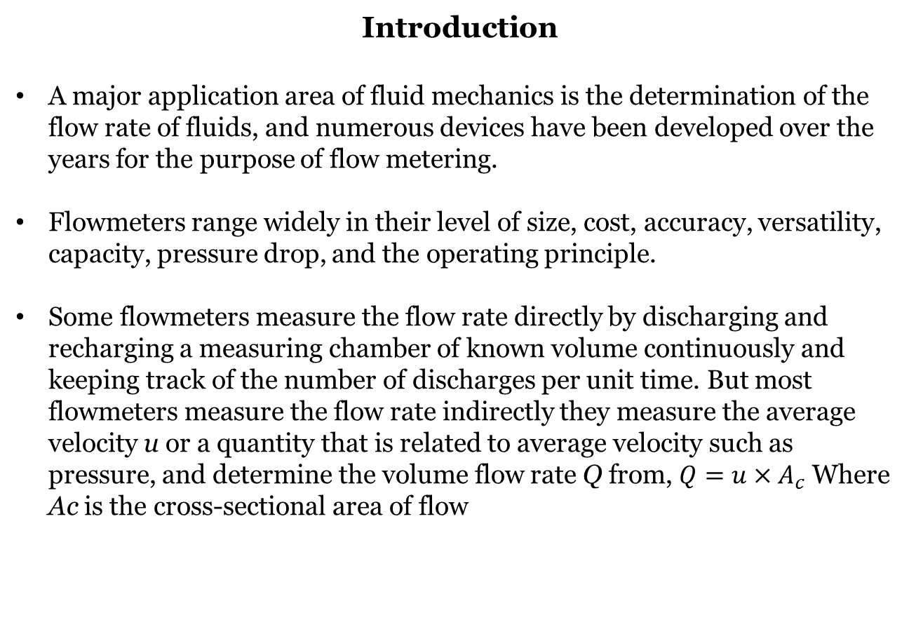
Introduction
A major application area of fluid mechanics is the determination of the flow rate of fluids, and numerous devices have been developed over the years for the purpose of flow metering.
Flowmeters range widely in their level of size, cost, accuracy, versatility, capacity, pressure drop, and the operating principle.
Some flowmeters measure the flow rate directly by discharging and recharging a measuring chamber of known volume continuously and keeping track of the number of discharges per unit time. But most flowmeters measure the flow rate indirectly they measure the average velocity u or a quantity that is related to average velocity such as pressure, and determine the volume flow rate Q from, $Q=u×A_{c}$ Where Ac is the cross-sectional area of flow

Slide 3
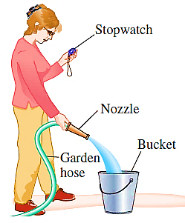
The flow rate of water through a garden hose, for example, can be measured simply by collecting the water in a bucket of known volume and dividing the amount collected by the collection time (Fig).
A crude way of estimating the flow velocity of a river is to drop a float on the river and measure the drift time between two specified locations.

Slide 4
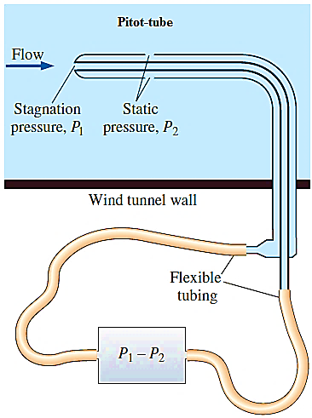
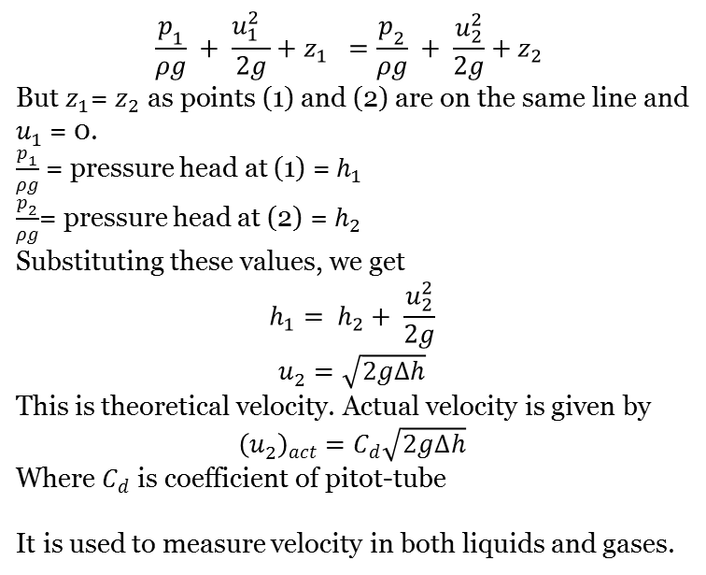
Pitot-tube
It is a device used for measuring the velocity at any point in a pipe or a channel.
It is based on the principle that if the velocity of flow at a point becomes zero, the pressure there is increased due to the conversion of the kinetic energy into pressure energy.
The pitot-tube consists of both a stagnation pressure tap and several circumferential static pressure taps and it measures both stagnation and static pressures (Fig)
$$\frac{p_{1}}{ρg} + \frac{{{u_{1}^{2}}^{ }}_{ }}{2g}+z_{1} =\frac{p_{2}}{ρg} + \frac{u_{2}^{2}}{2g}+z_{2}$$
But $z_{1}$= $z_{2}$ as points (1) and (2) are on the same line and $u_{1}^{ }$ = 0.
$\frac{p_{1}}{ρg}$ = pressure head at (1) = $h_{1}$
$\frac{p_{2}}{ρg}$= pressure head at (2) =$h_{2}$
Substituting these values, we get
$$h_{1}= h_{2}+ \frac{u_{2}^{2}}{2g}$$
$$u_{2}^{ }=\sqrt{2g∆h}$$
This is theoretical velocity. Actual velocity is given by
$${\left(u_{2}^{ }\right)}_{act}=C_{d}\sqrt{2g∆h}$$
Where $C_{d}$ is coefficient of pitot-tube
It is used to measure velocity in both liquids and gases.

Slide 5
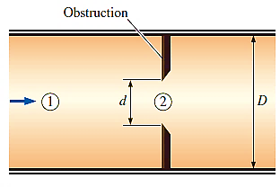
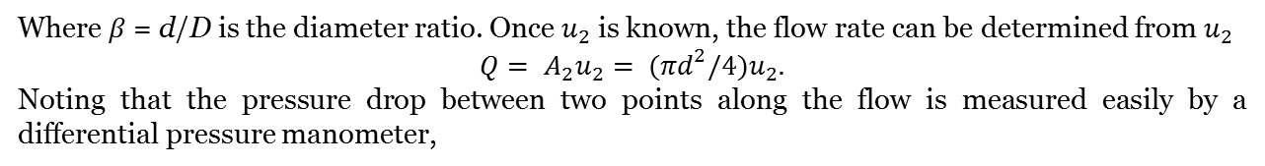
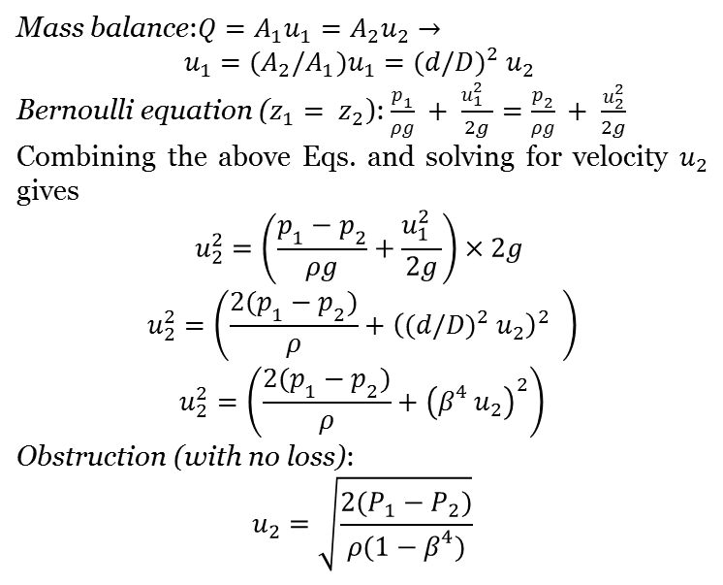
Obstruction Flowmeters: Orifice, Venturi, and Nozzle Meters
Consider incompressible steady flow of a fluid in a horizontal pipe of diameter D that is constricted to a flow area of diameter d, as shown in Fig.
Mass balance:$Q=A_{1}u_{1}=A_{2}u_{2}→$
$$u_{1}=(A_{2}/A_{1})u_{1}={(d/D)}^{2} u_{2}$$
Bernoulli equation ($z_{1}= z_{2}$):$\frac{p_{1}}{ρg} + \frac{{{u_{1}^{2}}^{ }}_{ }}{2g}=\frac{p_{2}}{ρg} + \frac{u_{2}^{2}}{2g}$
Combining the above Eqs. and solving for velocity $u_{2}$ gives
$$u_{2}^{2}=\left(\frac{p_{1}−p_{2}}{ρg}+\frac{{{u_{1}^{2}}^{ }}_{ }}{2g}\right)×2g$$
$$u_{2}^{2}=\left(\frac{{2(p}_{1}−p_{2})}{ρ}+{{{\left({(d/D)}^{2} u_{2}\right)}_{ }^{2}}^{ }}_{ }\right)$$
$$u_{2}^{2}=\left(\frac{{2(p}_{1}−p_{2})}{ρ}+{\left(β^{4} u_{2}\right)}_{ }^{2}\right)$$
Obstruction (with no loss):
$$u_{2}=\sqrt{\frac{2(P_{1}−P_{2})}{ρ(1−β^{4})}}$$
Where $β$ = d/D is the diameter ratio. Once $u_{2}$ is known, the flow rate can be determined from $u_{2}$
$$Q= A_{2}u_{2}= (πd^{2}/4)u_{2}.$$
Noting that the pressure drop between two points along the flow is measured easily by a differential pressure manometer,

Slide 6
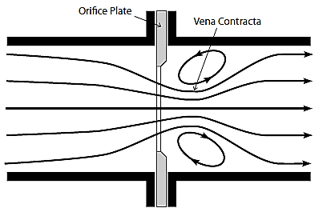
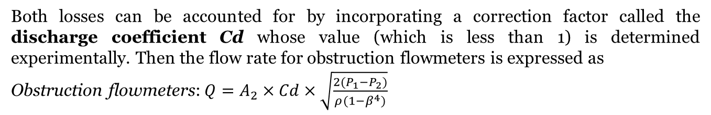
The velocity in Eq. above is obtained by assuming no loss, and thus it is the maximum velocity that can occur at the constriction site. In reality, some pressure losses due to:
frictional effects are inevitable, and thus the actual velocity is less.
Also, the fluid stream continues to contract past the obstruction, and the vena contracta area is less than the flow area of the obstruction.
Both losses can be accounted for by incorporating a correction factor called the discharge coefficient Cd whose value (which is less than 1) is determined experimentally. Then the flow rate for obstruction flowmeters is expressed as
Obstruction flowmeters:${Q=A}_{2}×Cd×\sqrt{\frac{2(P_{1}−P_{2})}{ρ(1−β^{4})}}$
The value of Cd can be taken to be 0.96 for flow nozzles and 0.61 for orifices.
Owing to its streamlined design, the discharge coefficients of Venturi meters are very high, ranging between 0.95 and 0.99 in the absence of specific data, we can take Cd = 0.98 for Venturi meters.

Slide 7
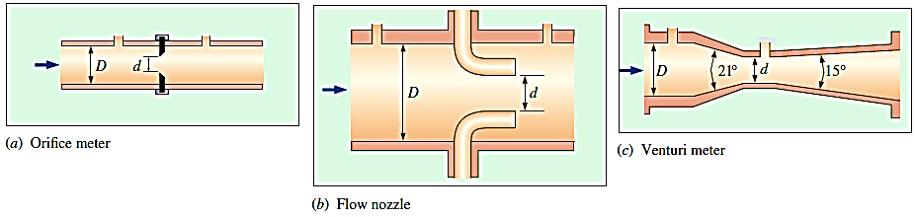
Comparison
The orifice meter has the simplest design and it occupies minimal space as it consists of a plate with a hole in the middle, but the sudden change in the flow area in orifice meters causes considerable swirl and thus significant head loss or permanent pressure loss.
In nozzle meters, the plate is replaced by a nozzle, and thus the flow in the nozzle is streamlined. As a result, the vena contracta is practically eliminated and the head loss is smaller. However, flow nozzle meters are more expensive than orifice meters.
The Venturi meter, is the most accurate flowmeter in this group, but it is also the most expensive. Its gradual contraction and expansion prevent flow separation and swirling, and it suffers only frictional losses on the inner wall surfaces. Venturi meters cause very low head losses, and thus, they should be preferred for applications that cannot allow large pressure drops.

Slide 8
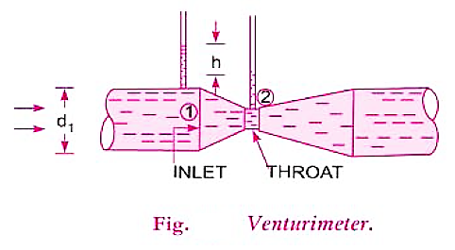
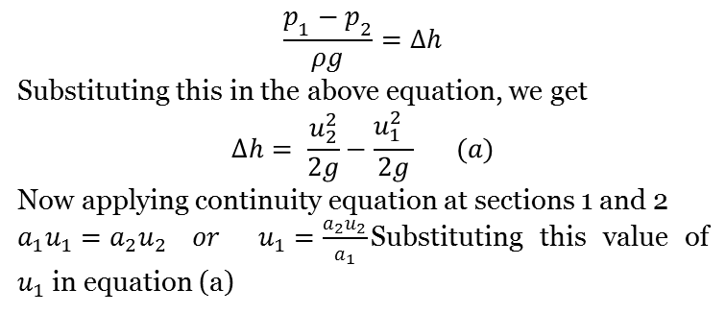
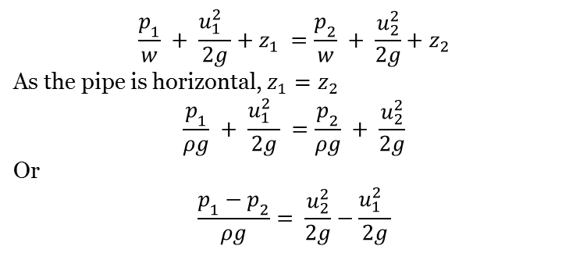
Venturimeter
A Venturimeter is a device used for measuring the rate of a flow of a fluid flowing through a pipe. It consists of three parts:
(i) A short converging part, (ii) Throat, and (iii) Diverging part. It is based on the Principle of Bernoulli's equation.
Consider a Venturimeter fitted in a horizontal pipe through which a fluid is flowing (say water), as shown in the fig.
$$\frac{p_{1}}{w} + \frac{{{u_{1}^{2}}^{ }}_{ }}{2g}+z_{1} =\frac{p_{2}}{w} + \frac{u_{2}^{2}}{2g}+z_{2}$$
As the pipe is horizontal, $z_{1}=z_{2}$
$$\frac{p_{1}}{ρg} + \frac{{{u_{1}^{2}}^{ }}_{ }}{2g} =\frac{p_{2}}{ρg} + \frac{u_{2}^{2}}{2g}$$
Or
$$\frac{p_{1}−p_{2}}{ρg}= \frac{u_{2}^{2}}{2g}−\frac{{{u_{1}^{2}}^{ }}_{ }}{2g}$$
$$\frac{p_{1}−p_{2}}{ρg}=∆h$$
Substituting this in the above equation, we get
$$∆h= \frac{u_{2}^{2}}{2g}−\frac{{{u_{1}^{2}}^{ }}_{ }}{2g} (a)$$
Now applying continuity equation at sections 1 and 2
$a_{1}u_{1}=a_{2}u_{2} or u_{1}=\frac{a_{2}u_{2}}{a_{1}}$Substituting this value of $u_{1}$ in equation (a)

Slide 9
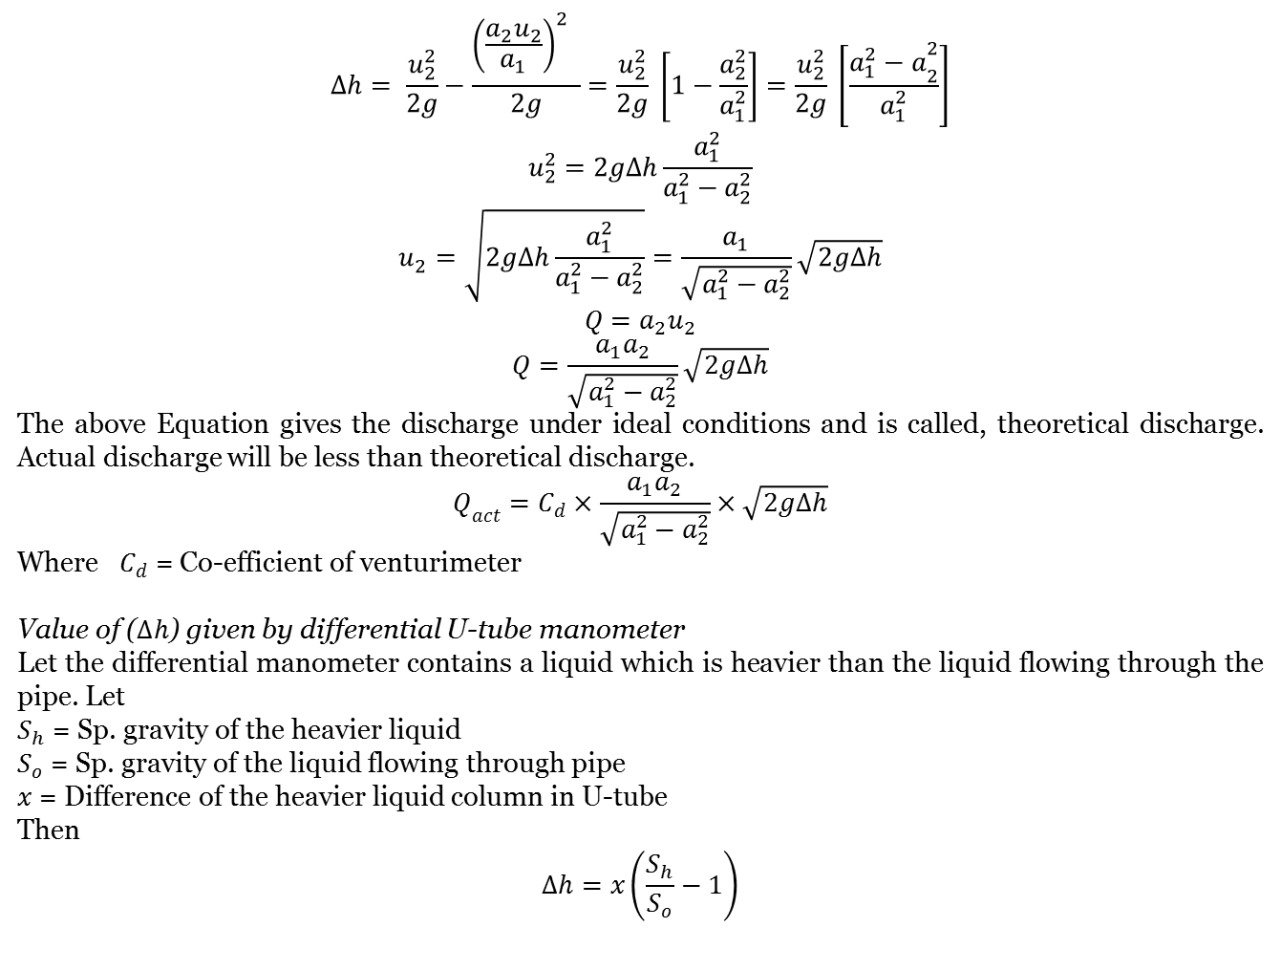
$$∆h= \frac{u_{2}^{2}}{2g}−\frac{{{{\left(\frac{a_{2}u_{2}}{a_{1}}\right)}_{ }^{2}}^{ }}_{ }}{2g}=\frac{u_{2}^{2}}{2g} \left[1−\frac{a_{2}^{2}}{a_{1}^{2}}\right]=\frac{u_{2}^{2}}{2g} \left[\frac{{a_{1}^{2}−a}_{2}^{2}}{a_{1}^{2}}\right]$$
$$u_{2}^{2}=2g∆h\frac{a_{1}^{2}}{a_{1}^{2}−a_{2}^{2}}$$
$$u_{2}^{ }=\sqrt{2g∆h\frac{a_{1}^{2}}{a_{1}^{2}−a_{2}^{2}}}=\frac{a_{1}}{\sqrt{a_{1}^{2}−a_{2}^{2}}}\sqrt{2g∆h}$$
$$Q=a_{2}u_{2}$$
$$Q=\frac{a_{1}a_{2}}{\sqrt{a_{1}^{2}−a_{2}^{2}}}\sqrt{2g∆h}$$
The above Equation gives the discharge under ideal conditions and is called, theoretical discharge. Actual discharge will be less than theoretical discharge.
$$Q_{act}=C_{d}×\frac{a_{1}a_{2}}{\sqrt{a_{1}^{2}−a_{2}^{2}}}×\sqrt{2g∆h}$$
Where $C_{d}$ = Co-efficient of venturimeter
Value of ($∆h$) given by differential U-tube manometer
Let the differential manometer contains a liquid which is heavier than the liquid flowing through the pipe. Let
$S_{h}$ = Sp. gravity of the heavier liquid
$S_{o}$ = Sp. gravity of the liquid flowing through pipe
$x$ = Difference of the heavier liquid column in U-tube
Then
$$∆h=x\left(\frac{S_{h}}{S_{o}}−1\right)$$

Slide 10
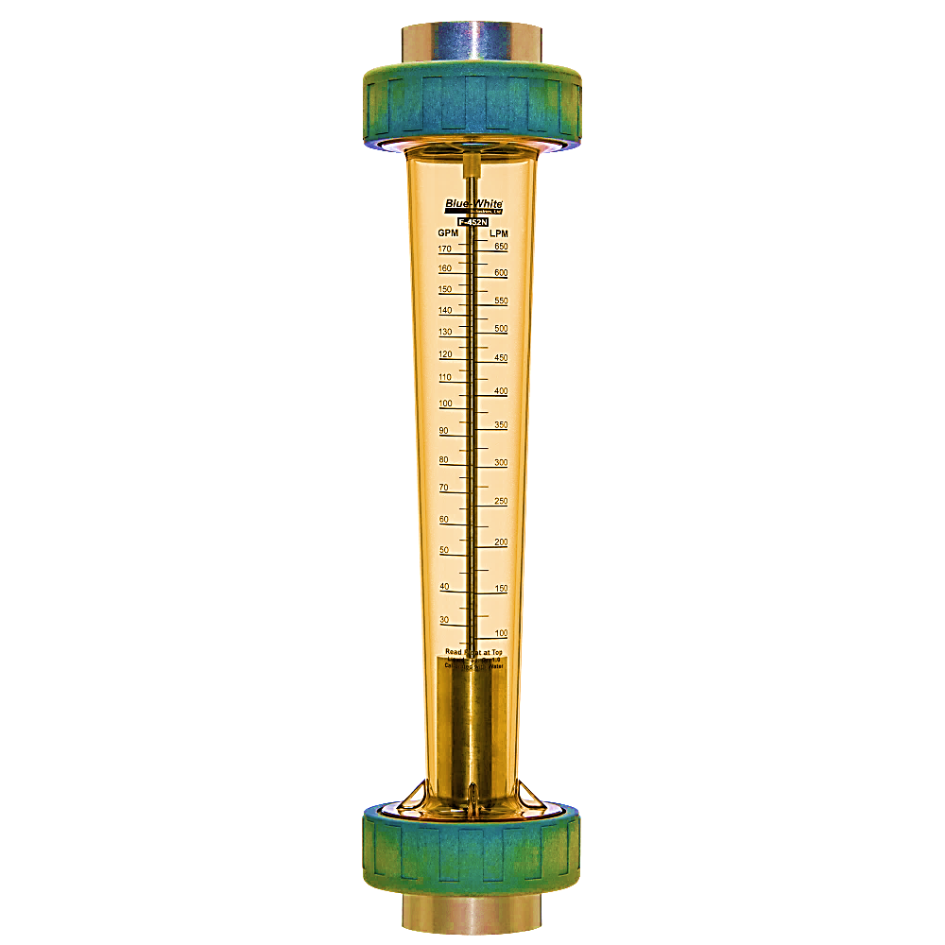
Variable-Area Flowmeters (Rotameters)
A simple, reliable, inexpensive, and easy-to-install flowmeter with reasonably low pressure drop and no electrical connections that gives a direct reading of flow rate for a wide range of liquids and gases is the variable-area flowmeter
The velocity along the tapered tube decreases in the flow direction because of the increase in the cross-sectional area. There is a certain velocity that generates enough drag to balance the float weight and the buoyancy force
The degree of tapering of the tube can be made such that the vertical rise changes linearly with flow rate, and thus the tube can be calibrated linearly for flow rates

Slide 11
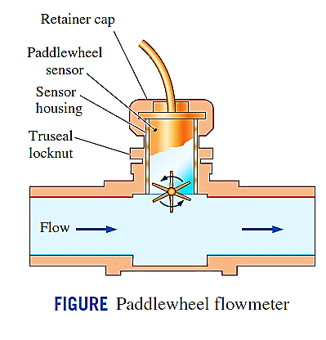
Paddlewheel flowmeter
To measure liquid flow
Working:
A sensor detects the passage of each of the paddlewheel blades and transmits a signal. A microprocessor then converts this rotational speed information to flow rate.

